Slide 1



Movie Recommendation System
Group 2 :
Eswar Revanth Chigurupati
Parul Ghai
Prateek Gupta
Rohan Nitin Khandke
Yasasvi Keerthi

Slide 2

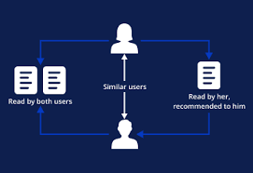
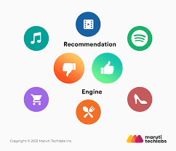
Agenda
Introduction
Objective
Types Of Recommendation System
Data Used
Model and its overview
Model Training and Features
Results
Evaluation Metrics

Slide 3

Introduction
Recommendation System: Recommendation System produce a ranked list of items on which a user might be interested, in the context of current/past choice of an items.
Subclass of Information filtering system that seek to predict the ‘rating’ or ‘preference’ that a user would give to them.
Helps deciding in what to watch.
Applied in variety of applications like Movies, Books etc.

Slide 4

Objective
The objective of implementing a movie recommendation system is to enhance user experience by providing personalized and relevant movie suggestions. the system aims to:
Tailor Recommendations to User Preferences
Identify Similar INTEREST
Improve Recommendation Quality

Slide 5
Types Of Recommender System
Content-Based Recommendation: It is supervised machine learning used to induce a classifier to discriminate between interesting and uninteresting items for the user.
Collaborative Filtering: Collaborative recommends items based on similarity measures between users and/or items. The basic assumption behind the algorithm is that users with similar interests have common preferences.

Slide 6

Collaborative Filtering
Collaborative Filtering uses a user-item matrix to generate recommendations. This matrix contains the values that indicate a user’s preference towards a given item. These values can represent either explicit feedback (direct user ratings) or implicit feedback (indirect user behavior such as listening, purchasing, watching).
Explicit Feedback: The amount of data that is collected from the users when they choose to do so. Many of the times, users choose not to provide data for the user. So, this data is scarce and sometimes costs money. For example, ratings from the user.
Implicit Feedback: In implicit feedback, we track user behavior to predict their preference.

Slide 7
Steps Involved
Loading Data
Here, we included 2 datasets named ‘movies’ and ‘ratings’, which gives all the information about the movies, users and the ratings.
Here, we performed Statistical Analysis of data, to find unique movies, userid’s, ratings. These metrics provide important information about the properties of dataset.
Trained the recommendation model using the selected dataset
Statistical Analysis
Model Training and Evaluation
User-matrix/ Feature creation
This is a basic data-structure used in the recommendation systems, to train the model
Evaluation techniques such as precision, recall is used to evaluate the model.

Slide 8
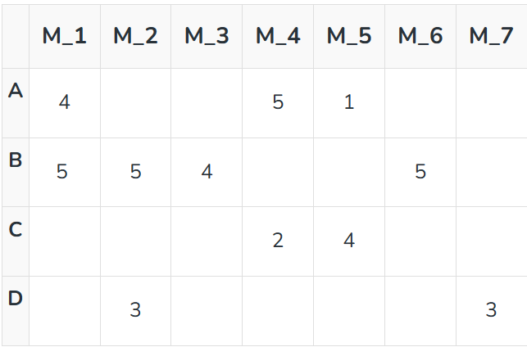
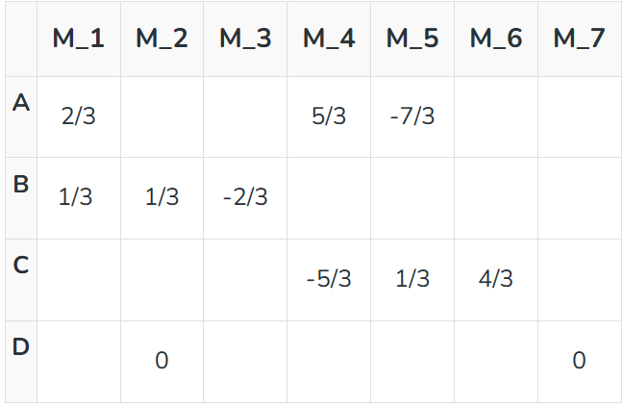
Consider a user x, we need to find another user whose rating are similar to x’s rating, and then we estimate x’s rating based on another user.
Create a matrix representing different user and movies
Consider two users x, y rating vectors r_{x} and r_{y}. We need to decide on a similarity matrix to calculate similarity b/w sim(x,y) using Cosine similarity.

Slide 9


Implementation

Slide 10
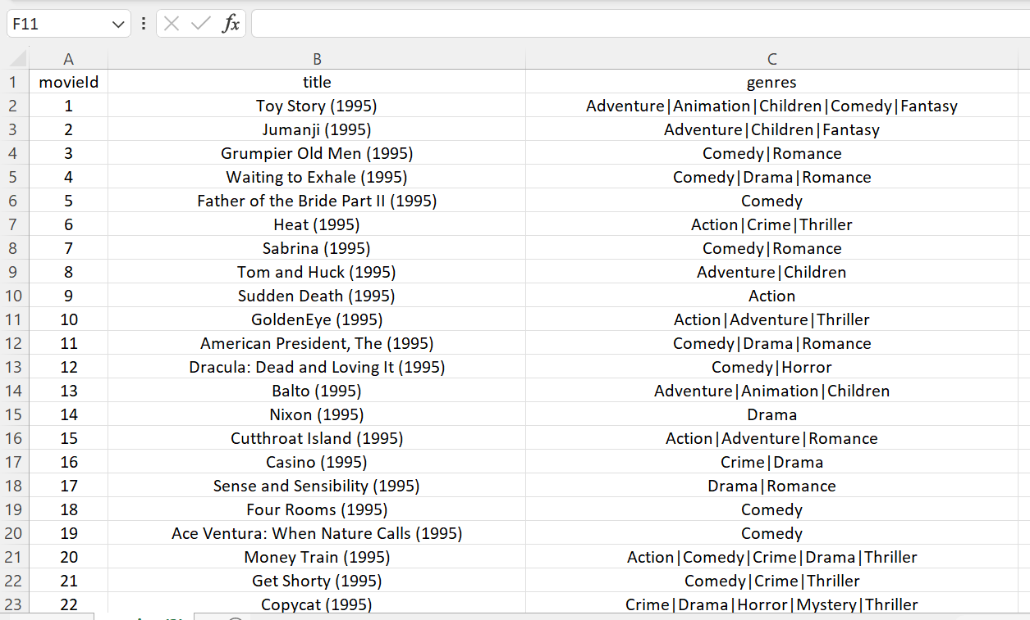
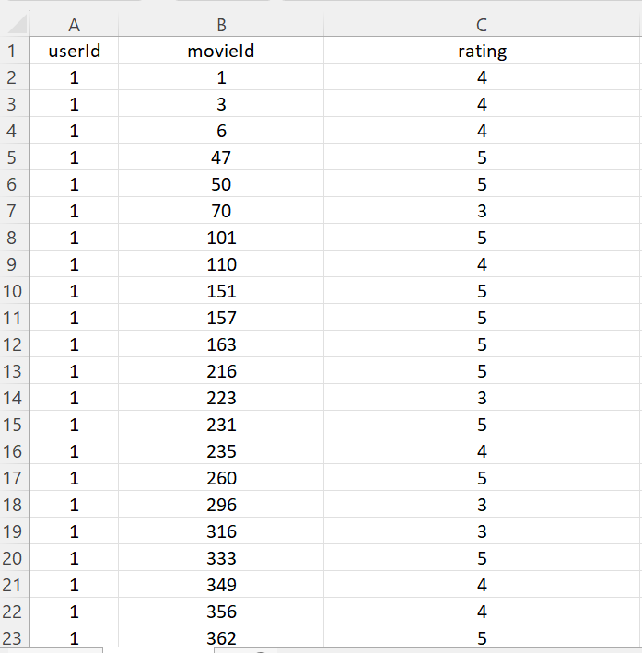
LOADING THE DATASETS
Two types of dataset: Movie & Rating
Dataset Source- KAGGLE
Movies
RATING

Slide 11
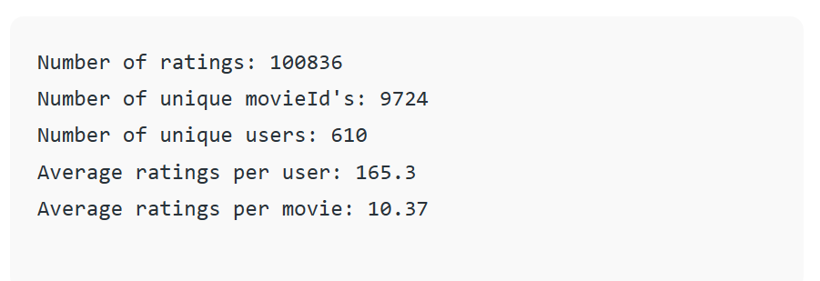
Statistical Analysis of Ratings
It counts the number of unique movie IDs (n_movies) and user IDs (n_users) as well as the total number of ratings (n_ratings). These metrics provide important information about the properties of the dataset, including its size and the variety of people and movies inside it.

Slide 12
User-Item Matrix Creation
Introduction
In a movie recommendation system, the user-item matrix is a fundamental concept that organizes user preferences and item features in a structured format.
User Item Matrix:
The user-item matrix is a table where rows represent users, columns represent items (movies), The values in the matrix represent user preferences or interactions with the movies (e.g., ratings, views, likes).

Slide 13
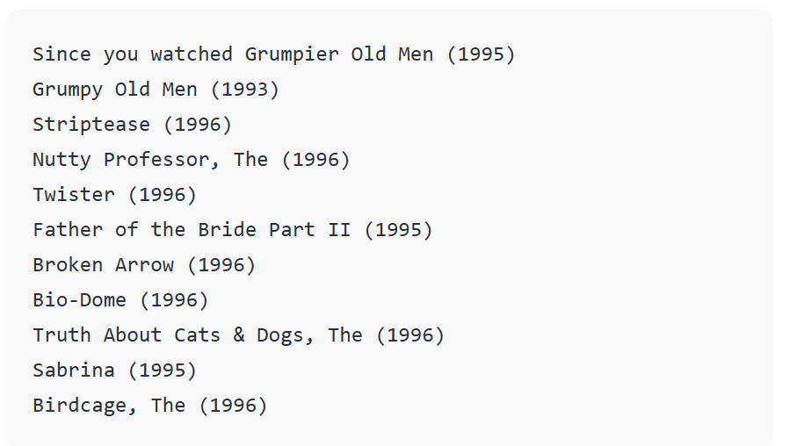
Movie Similarity Analysis
the k-Nearest Neighbors (KNN) algorithm IS USED to identify movies that are similar to a given movie.
The function takes inputs such as the target movie ID, a user-item matrix (X), the number of neighbors to consider (k), a similarity metric (default is cosine similarity), and an option to show distances between movies.
The function begins by initializing a blank list to hold the IDs of films that are comparable. It takes the target movie’s index out of the movie_mapper dictionary and uses the user-item matrix to acquire the feature vector that goes with it.
Next, the KNN model is configured using the given parameters.
The distances and indices of the k-nearest neighbors to the target movie are calculated once the KNN model has been fitted.

Slide 14

Cosine Similarity
Cosine Similarity for Recommendations:
In a movie recommendation system, cosine similarity is used to find movies that are most similar to a target movie based on user preferences. The higher the cosine similarity between two movies, the more alike they are in terms of user preferences.
Advantage: Cosine similarity is advantageous in handling sparse data (missing ratings) and is effective in capturing similarities between movies even when user ratings are on different scales.

Slide 15
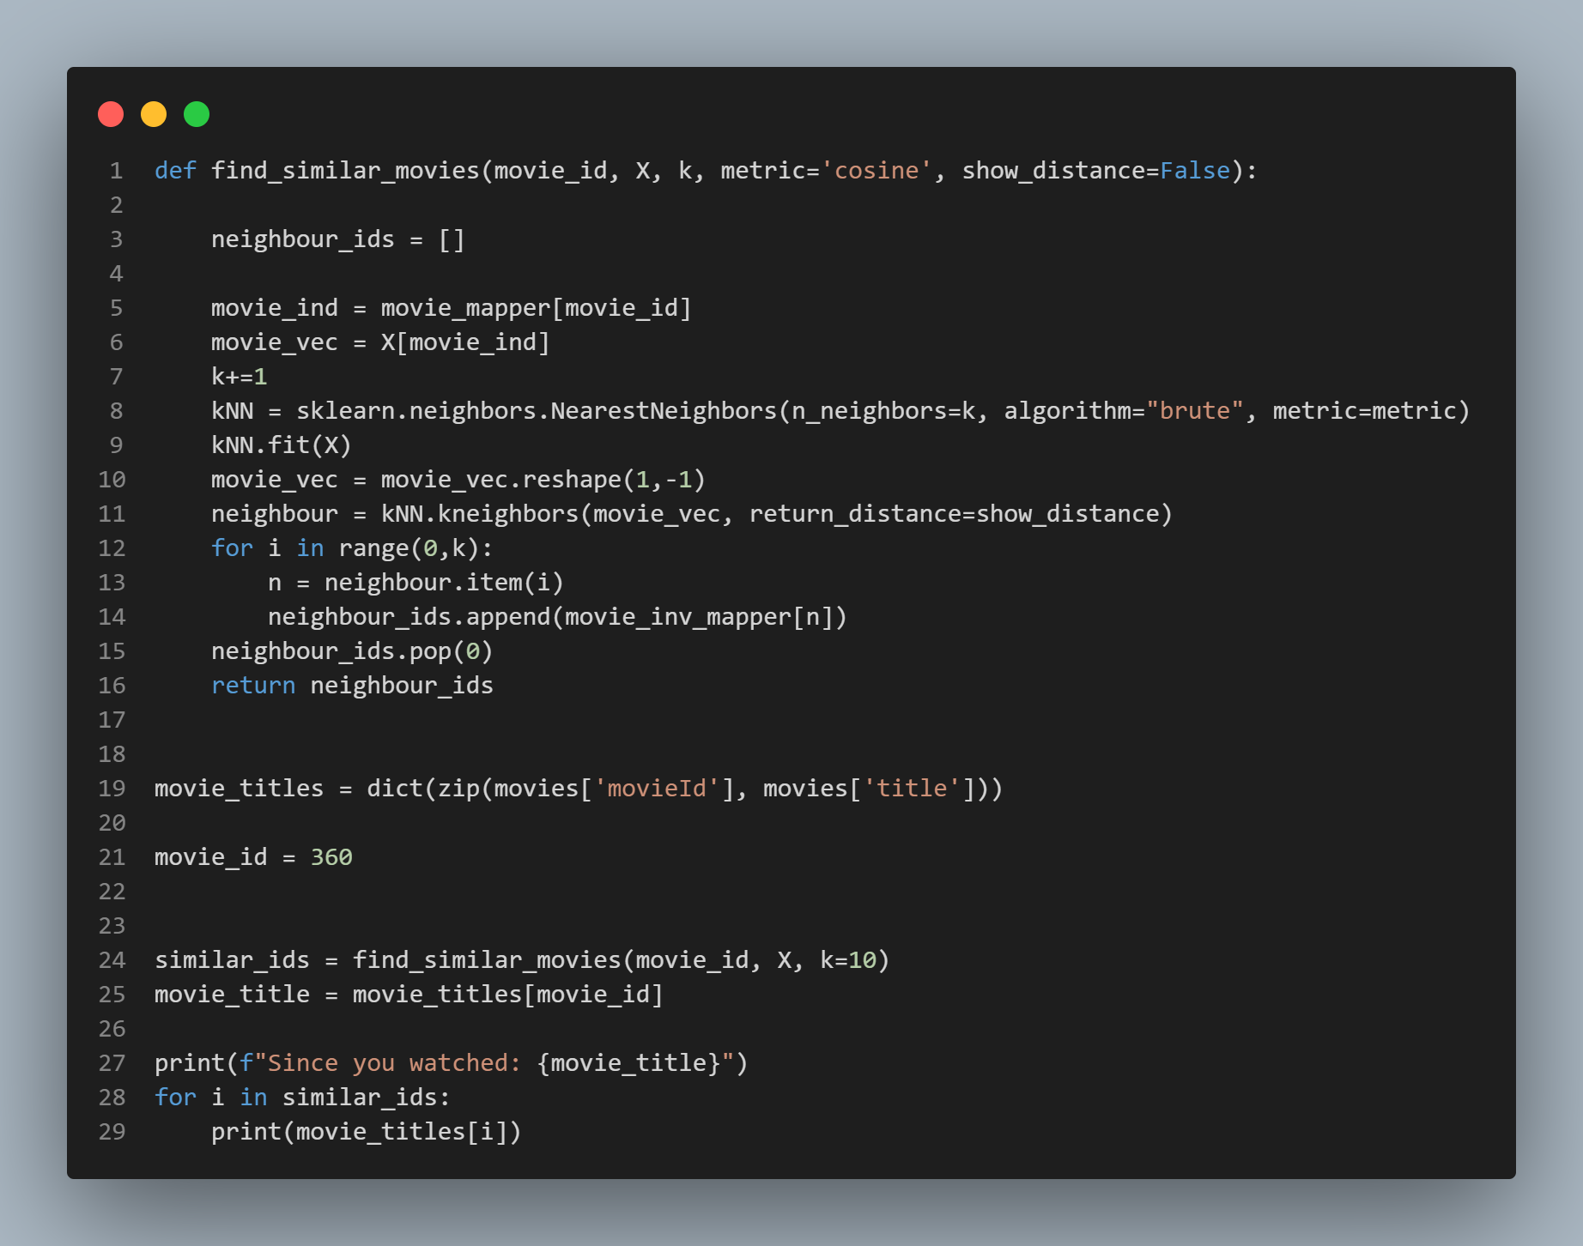
Movies Recommended by the algorithm

Slide 16
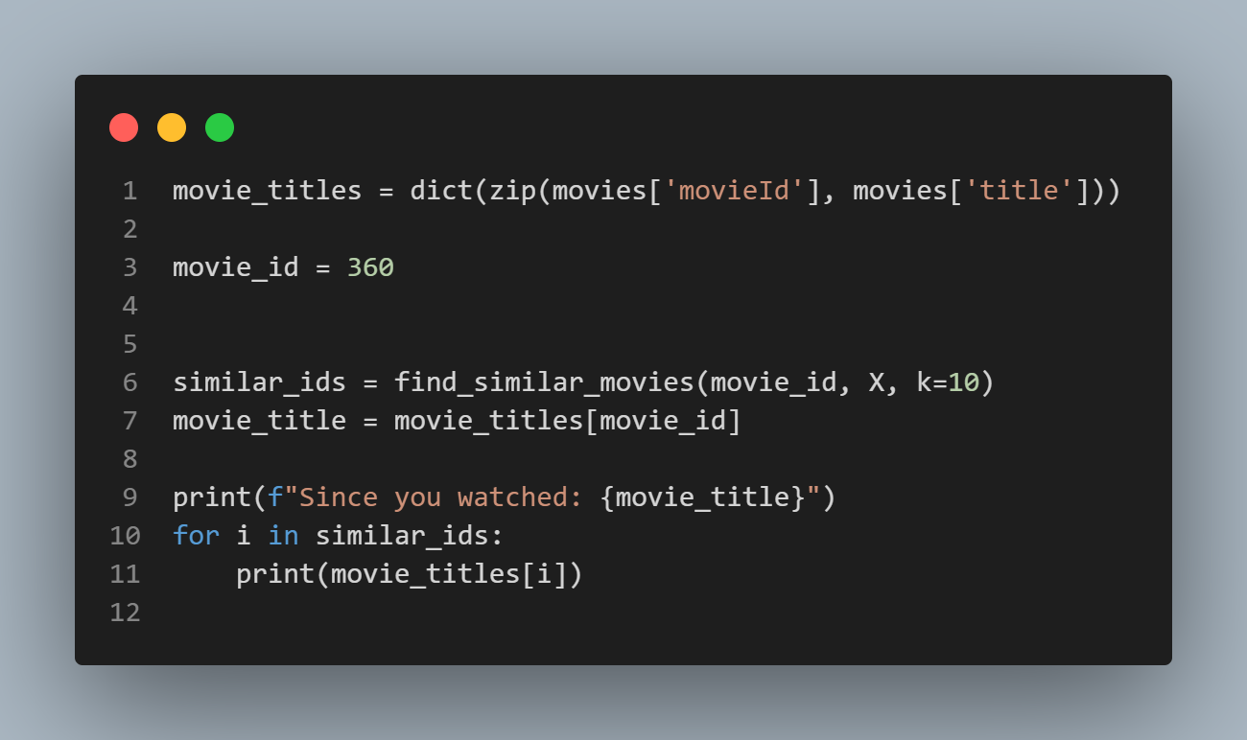
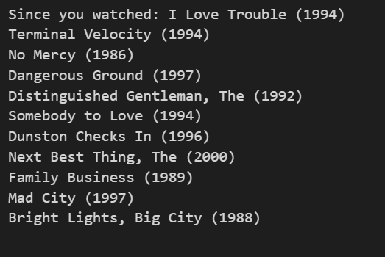
Recommendation w.r.t movie_id

Slide 17
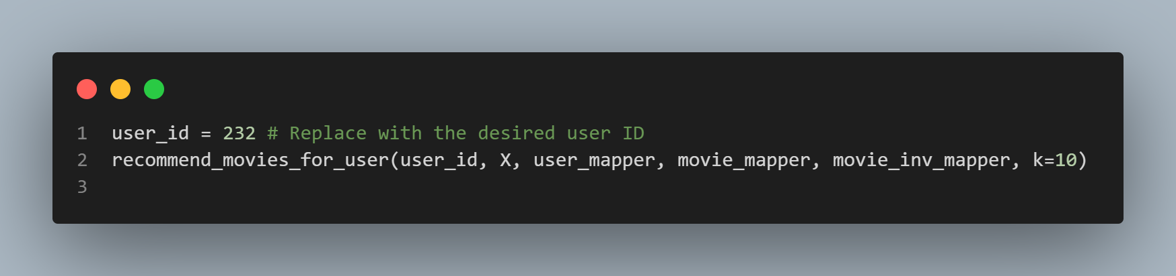
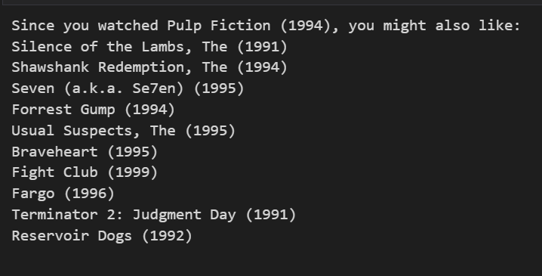
Recommendation w.r.t user_id

Slide 18
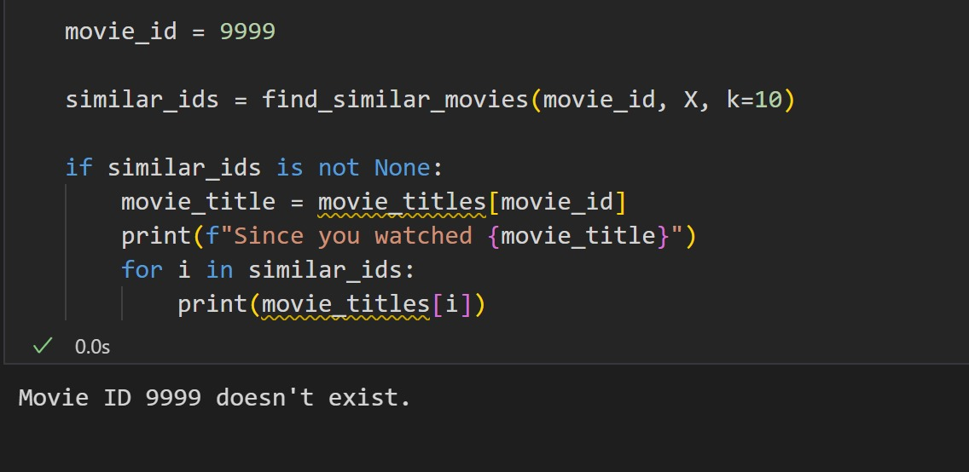
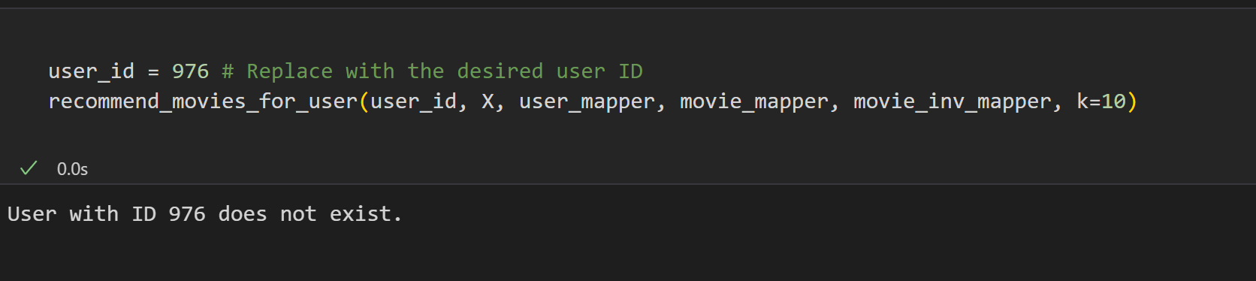
If the user_id or movie_id doesn’t exist

Slide 19

Evaluation Metrics
1. Precision:
Definition: Precision is a measure of accuracy that evaluates the relevance of the recommended items. It answers the question: Of all the recommended movies, how many are truly relevant to the user?
Formula: Precision = (Number of Relevant Items Recommended) / (Total Number of Recommended Items)
Interpretation: A high precision score indicates that a significant portion of the recommended movies align with the user's preferences.
2. Recall:
Definition: Recall measures the system's ability to capture all the relevant items for a user. It answers the question: Of all the relevant movies, how many were successfully recommended?
Formula: Recall = (Number of Relevant Items Recommended) / (Total Number of Relevant Items)
Interpretation: A high recall score signifies that the recommendation system effectively identifies and suggests a substantial portion of movies that a user would find relevant.

Slide 20
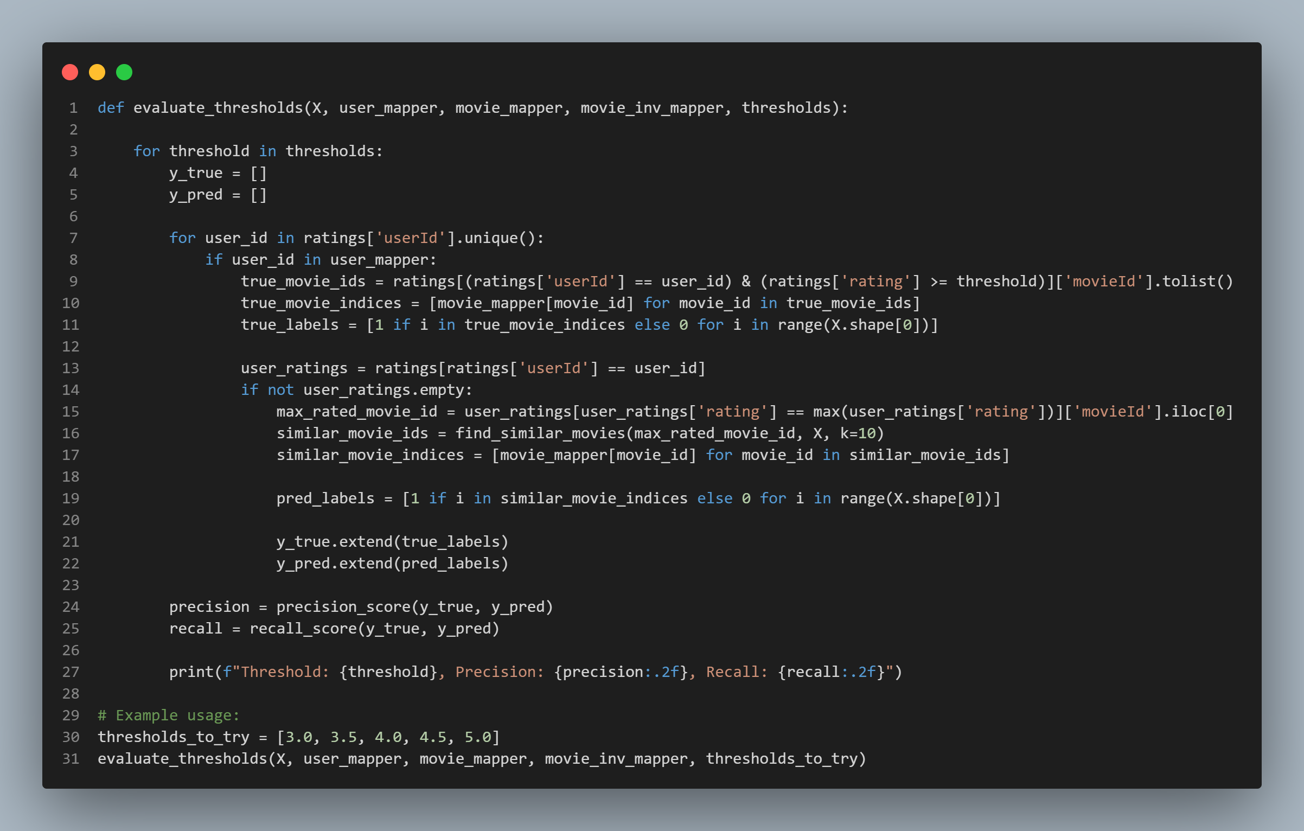
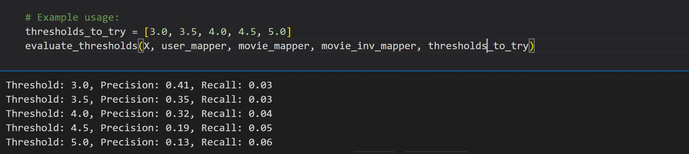

Slide 21
Thank You!

